Slide 1
Web Development & Design Foundations with XHTML
Chapter 1
Key Concepts

Slide 2
EVOLUTION OF THE INTERNET
Chapter 1

Slide 3
The Evolution of the Internet
Internet
  Interconnected network of computer networks
  ARPAnet
    Advanced Research Project Agency
    1969 – four computers connected
  NSFnet
    National Science Foundation
  Use of the Internet was originally limited to government, research and academic use
  1991 Commercial ban lifted

Slide 4
Intranet &
Extranets
Intranet
  A private network contained within an organization or business used to share information and resources among coworkers.
Extranet
  A private network that securely shares part of an organization’s information or operations with external partners

Slide 5
Growth of Internet
Hobbes Internet Timeline
  http://www.zakon.org/robert/internet/timeline/
Year
1969
1989
1992
1995
2001
2002
2003
2006
Host Computers
4
100,000
1,000,000
8,000,000
109,000,000
147,000,000
171,600,000
439,000,000

Slide 6
Reasons for
Internet Growth in the 1990s
Removal of the ban on commercial activity
Development of the World Wide Web by Tim Berners-Lee at CERN
Development of Mosaic, the first graphics-based web browser at NCSA
Notes:
Tim Berners-Lee created the World Wide Web in 1991

Slide 7

The World Wide Web
The graphical user interface to information stored on some of the computers connected to the Internet.
Notes:
In 1993 the first graphics based web browser, Mosaic, became available.

Slide 8
INTERNET STANDARDS ORGANIZATIONS
Chapter 1

Slide 9
Internet Standards & Coordination
The Internet Society
www.isoc.org
  A professional organization that provides leadership in addressing issues related to the future of the Internet
  IETF-- Internet Engineering Task Force
    RFC – Requests for Comments
  IAB – Internet Architecture Board
Notes:
Isoc is responsible for internet infrastructure standards

Slide 10
Internet Standards & Coordination
ICANN - The Internet Corporation for Assigned Numbers & Names
  Non-profit organization
  Main function is to coordinate the assignment of:
    Internet domain names
    IP address numbers
    Protocol parameters
    Protocol port numbers.

Slide 11
Web Standards and the W3C Consortium
W3C – World Wide Web Consortium
  Develops recommendations and prototype technologies related to the Web
  Produces specifications, called Recommendations, in an effort to standardize web technologies
  WAI – Web Accessibility Initiative
Notes:
W3C addresses: Web architecture, user interface, technology, and society

Slide 12
Web
Accessibility
WAI – Web Accessibility Initiative
  Develops recommendations for
    web content developers,
    web authoring tool developers,
    developers of web browsers, and
    developers of other user agents to facilitate use of the web by those with special needs.
  WCAG
    Web Content Accessibility Guidelines
    http://www.w3.org/WAI/WCAG20/quickref/

Slide 13
Web
Accessibility
Section 508 of the Rehabilitation Act
  requires that government agencies must give individuals with disabilities access to information technology that is comparable to the access available to others

Slide 14
NETWORKS
Chapter 1

Slide 15
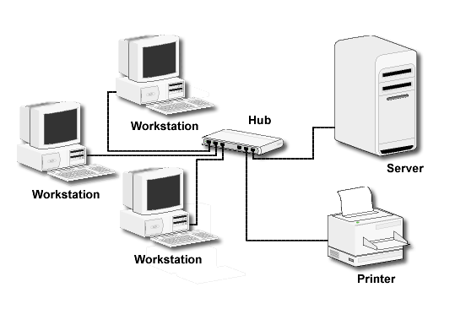
Network
Overview
Network -- two or more computers connected together for the purpose of communicating and sharing resources

Slide 16
Networks
LAN -- Local Area Network
  Usually confined to a single building or group of buildings
MAN -- Metropolitan Area Network
  Connects computer resources in a local geographical area
WAN -- Wide Area Network
  Usually uses some form of public or commercial communications network to connect computers in widely dispersed geographical areas.

Slide 17
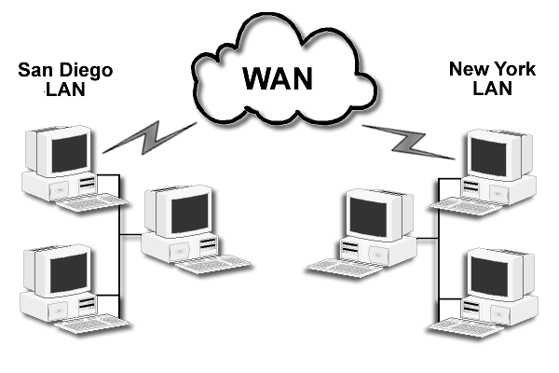
A WAN connecting two LANs

Slide 18
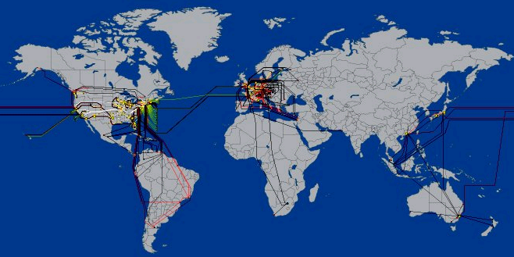
Internet
Infrastructure
Internet Backbone
A high capacity communication link that carries data gathered from smaller links that interconnect with it.
NAP – Network Access Point
Access points or junctions to the Internet Backbone in major cities.

Slide 19
CLIENT/SERVER MODEL
Chapter 1

Slide 20
The Client/Server
Model
Client/Server can describe a relationship between two computer programs – the "client" and the "server".
Client
  requests some type of service (such as a file or database access) from the server.
Server
  fulfills the request and transmits the results to the client over a network

Slide 21
The Client/Server
Model
The Internet Client/Server Model
  Client -- Web Browser
  Server -- Web Server

Slide 22
Web
Client
Connected to the Internet when needed
Usually runs web browser (client) software such as Internet Explorer or Netscape
Uses HTTP (Hypertext Transfer Protocol)
Requests web pages from server
Receives web pages and files from server

Slide 23
Web
Server
Continually connected to the Internet
Runs web server software (such as Apache or Internet Information Server)
Uses HTTP (Hypertext Transfer Protocol)
Receives request for the web page
Responds to request and transmits status code, web page, and associated files

Slide 24
MIME
Type
Multi-Purpose Internet Mail Extension
  a set of rules that allow
  multimedia documents
  to be exchanged among
  many different computer systems
Notes:
Use of MIME has been extended beyond just e-mail. It is used with HTTP to identify document types.

Slide 25
INTERNET PROTOCOLS
Chapter 1

Slide 26
Internet
Protocols
Protocols
  Rules that describe the methods used for clients and servers to communicate with each other over a network.
There is no single protocol that makes the Internet and Web work.
A number of protocols with specific functions are needed.

Slide 27
FTP
File Transfer Protocol
A set of rules that allow files to be exchanged between computers on the Internet.
Web developers commonly use FTP to transfer web page files from their computers to web servers.
FTP is also used to download programs and files from other servers to individual computers.

Slide 28

E-mail
Protocols
Sending E-mail
  SMTP Simple Mail Transfer Protocol
Receiving E-mail
  POP (POP3) Post Office Protocol
  IMAP Internet Mail Access Protocol

Slide 29
HTTP
Hypertext Transfer Protocol
A set of rules for exchanging files such as text, graphic images, sound, video, and other multimedia files on the Web.
Web browsers send HTTP requests for web pages and their associated files.
Web servers send HTTP responses back to the web browsers.
HTTP Request
HTTP Response

Slide 30
TCP/IP
Transmission Control Protocol/Internet Protocol
TCP/IP has been adopted as the official communication protocol of the Internet.
TCP and IP have different functions that work together to ensure reliable communication over the Internet.

Slide 31
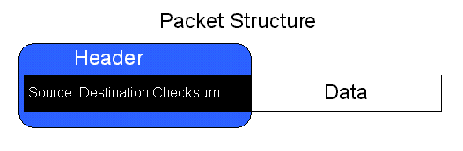
TCP
Transmission Control Protocol
Purpose is to ensure the integrity of communication
Breaks files and messages into individual units called packets

Slide 32
IP
Internet Protocol
A set of rules that controls how data is sent between computers on the Internet.
IP routes a packet to the correct destination address.
The packet gets successively forwarded to the next closest router (a hardware device designed to move network traffic) until it reaches its destination.
http://visualroute.visualware.com/
http://www.tracert.com/cgi-bin/trace.pl

Slide 33
IP Address
Each device connected to the Internet has a unique numeric IP address.
These addresses consist of a set of four groups of numbers, called octets.
64.233.167.99 will get you Google!
An IP address may correspond to a domain name.

Slide 34
URLS AND DOMAIN NAMES
Chapter 1

Slide 35
Domain
Name
Locates an organization or other entity on the Internet
Domain Name System
  Divides the Internet into logical groups and understandable names
  Associates unique computer IP Addresses with the text-based domain names you type into a web browser
  Browser: http://google.com
  DNS: 64.233.187.99

Slide 36

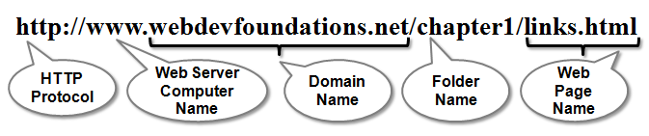
URL
Uniform Resource Locator
URL
Represents the address of a resource on the Internet.

Slide 37
TLD
Top-Level Domain Name
A top-level domain (TLD) identifies the right-most part of the domain name.
Current generic TLDs:
.com, .org, .net, .mil, .gov, .edu, .int, .aero, .asia, .cat, .jobs, .name, .biz, .museum, .info, .coop, .pro, .travel

Slide 38
County Code
TLDs
Two character codes originally intended to indicate the geographical location (country) of the web site.
In practice, it is fairly easy to obtain a domain name with a country code TLD that is not local to the registrant.
Examples:
  .tv, .ws, .au, .jp, .uk
  See http://www.iana.org/cctld/cctld-whois.htm

Slide 39
Domain Name System
The Domain Name System (DNS) associates Domain Names with IP addresses.
Each time a new URL is typed into a web browser:
  1.The DNS is accessed
  2.The corresponding IP address is obtained and returned to the web Browser
  3.The web browser sends an HTTP request to the destination computer with the corresponding IP address
  4.The HTTP request is received by the web server
  5.The necessary files are located and sent by HTTP responses to the web browser
  6.The web browser renders and displays the web page and associated files

Slide 40
MARKUP LANGUAGES
Chapter 1

Slide 41
Markup
Languages
SGML – Standard Generalized Markup Language
  A standard for specifying a markup language or tag set
HTML – Hypertext Markup Language
  The set of markup symbols or codes placed in a file intended for display on a web browser.

Slide 42
Markup
Languages (2)
XML – eXtensible Markup Language
  A text-based language designed to describe, deliver, and exchange structured information.
  It is not intended to replace HTML –
  it is intended to extend the power of HTML by separating data from presentation.

Slide 43
Markup
Languages (3)
XHTML – eXtensible Hypertext Markup Language
  Developed by the W3C as the reformulation of HTML 4.0 as an application of XML.
  It combines the formatting strengths of HTML 4.0 and the data structure and extensibility strengths of XML.

Slide 44
Markup
Languages (4)
HTML 5
  The next version of HTML 4 and XHTML 1
  http://www.w3.org/html/

Slide 45
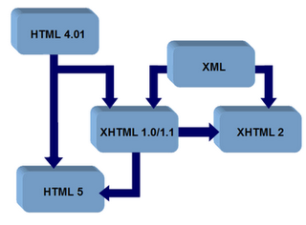
Markup
Languages (5)
The relationship between
XHTML, HTML, and XML

Slide 46
INTERNET AND WEB TRENDS
Chapter 1

Slide 47
Future Internet
& Web Trends
Continued importance of E-Commerce
Wireless Web access
Need for skilled technical workers
IPV6
Web Services
Blogs
RSS
Wikis
Web 2.0
Constant Change!

